Slide 1

LINEAR REGRESSION

Slide 2


Introduction to linear regression
Do you remember the two types of variables / features? ( Numerical and Categorical? )
Now is when this distinction makes sense as we can have two types of problems in supervised learning:
Regression: (prediction of a numerical feature)
Classification (prediction of a categorical feature)
Supervised learning

Slide 3
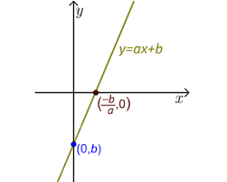
Introduction to machine learning
A linear regression model is a supervised parametric model ( it’s based on a given formula ) which has two parameters:
Slope (a)
Intercept (b)
A linear model can have multiple independent features.
Linear regression model

Slide 4
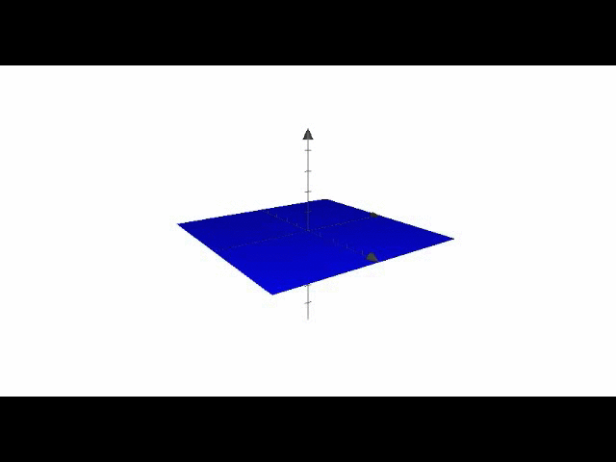
Introduction to machine learning
A linear model can have multiple independent features.
Multiple Linear regression model

Slide 5
Introduction to machine learning
Even if a relationship is not linear, sometimes it can be linearized.
Linearizing expressions

Slide 6
Introduction to machine learning
A linear regression model is one particular type of regression which is making the following four assumptions about the data:
Lineality ( the relation between the independent feature and the dependent feature is linear )
Independency: every observation used to train the model doesn’t depend of another.
Normality: all the variables (independent and dependent) are normally distributed.
Normality of errors made by model’s predictions are fairly constant
Linear regression assumptions

Slide 7
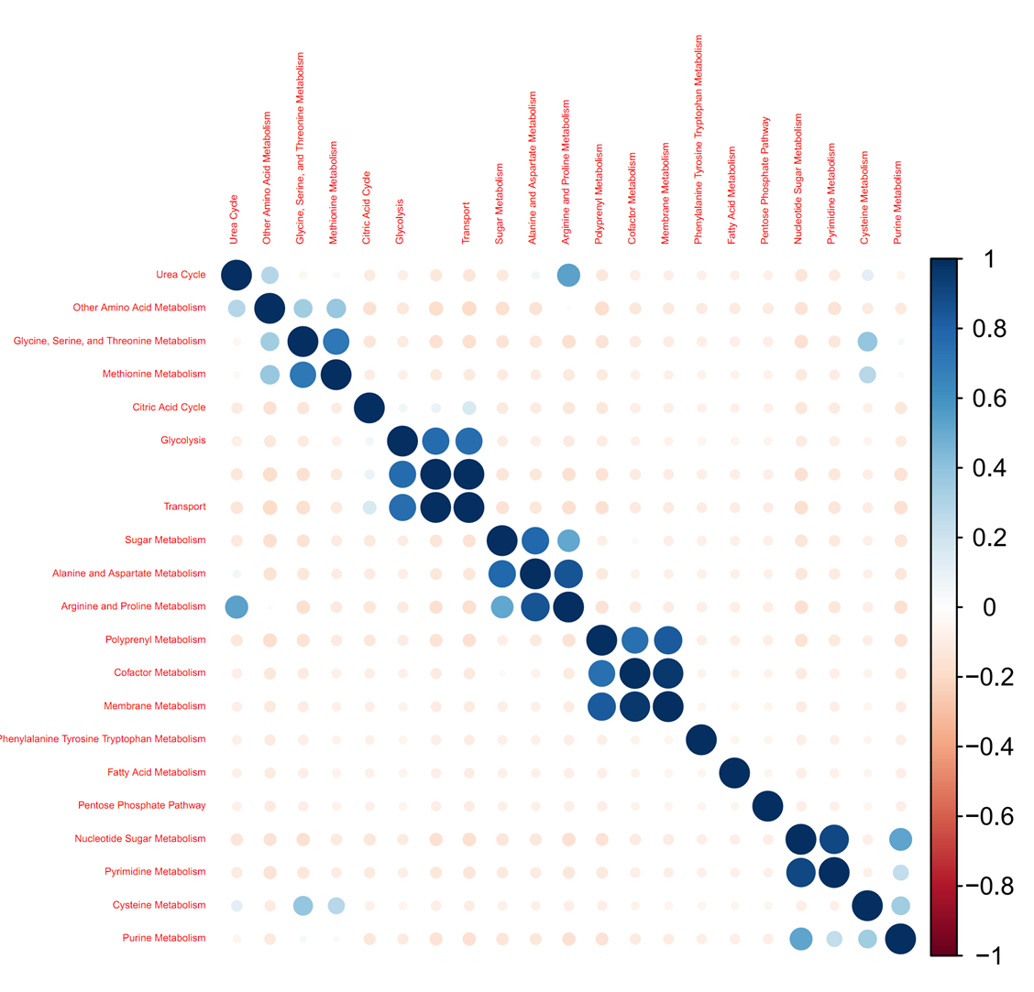
Introduction to machine learning
To check the linearity of the relationship between the dependent feature and the independent feature, check: correlation matrix.
The higher ( in absolute value ) the value of the correlation, the better. A minimum to consider a good correlation value is 0.75, but there is no consensus.
Checking for linearity: correlation matrix

Slide 8
Introduction to machine learning
Plot the distribution of each variable and check out if resembles a normal distribution.
If not, fit and apply a transformer/scaler:
power= PowerTransformer()
power.fit(X_train)
power.transform(X_train)
power.transform(X_test)
If you want to be picky checking for normality of a variable, you can use an statistical test like the: Shapiro-Wilks
Checking for normality

Slide 9

Data splitting
BEFORE CREATING ANY MODEL!!!
You can’t train ANY model using all your data. Otherwise, you can’t evaluate the performance of your new model in unseen data.
If you use all your data, your estimation of the model performance will be biased.
If you use new data to make predictions, then you don’t have the real values to evaluate the performance of your model!!!
What we can do then?

Slide 10
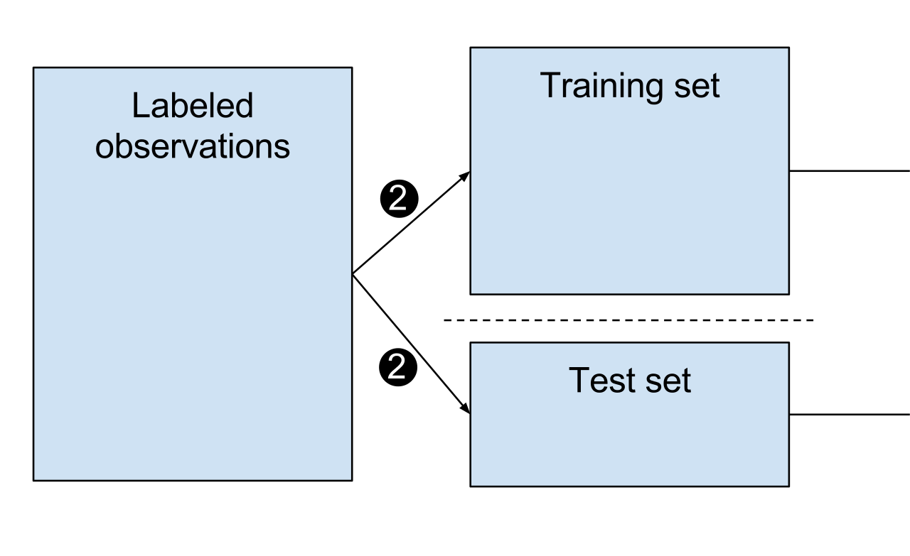
Data splitting and model selection
Split our original data in two sets:
Train and test sets:
Train set: 70-80% of the total data
Test set: 30-20% of the total data
How we decide in which set we place each row of our dataset?
Mostly at random except some specific situations
Now you train the model using the “train set” and you make predictions on the “test set”
Then you select the best model based on the best performance on the “test set”
trans.fit(x_train)
trans.transform(x_train)
model.fit(x_train,y_train)
trans.transform(x_test)
model.predict(x_test)

Slide 11
Data splitting and model selection
Using sklearn to perform data splitting and model generation:
from sklearn.model_selection import train_test_split
from sklearn.linear_model import LinearRegression
X_train, X_test, y_train, y_test = train_test_split(X, Y, test_size=0.3, random_state=100)
lm = LinearRegression() # fit_intercept = True
model = lm.fit(X_train,y_train)
predictions = model.predict(X_test)
model.coef_
model.intercept_

Slide 12
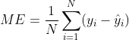
OLS
To answer this question, we need to think about how we quantify the error made by the model
If the model is perfect, the predictions are going to match the real values right?
Therefore, a first tentative can be to add the differences between the real values and the predicted ones:
WARNING!!! This is dangerous, we can have error compensation!!
How to determine the coefficients of a linear model (I)?

Slide 13
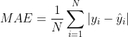
OLS
Then we need to get rid of the sign of the sign of the individual errors.
In other words, we want that all error contribute to the total error. Then, one possibility can be to take the absolute value:
However, this metric is problematic when determining the coefficients.
We need to consider another metric
How to determine the coefficients of a linear model (II)?

Slide 14
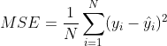
OLS
Another way to get rid of the sign of the individual errors is by means of the square:
This looks more feasible to minimize.
How to determine the coefficients of a linear model (II)?

Slide 15
OLS
In order to determine the optimal values for the linear model, this method makes MSE becomes minimum:
Ordinary least square method (OLS)

Slide 16
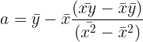
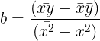
OLS
According to this method the values for the linear model are:
Ordinary least square method (OLS)

Slide 17
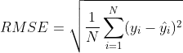
Error metrics in regression models
Metrics:
Sklearn mean absolute error
Sklearn mean squared error
Mean error:
It can suffer from error compensation.
The closer to zero, the better
Mean absolute error:
Not easy to minimize
The smaller the better
Mean squared error:
Easy to minimize
The smaller the better
Too sensitive to outliers in predictions
Squared units!
Root mean square error:
Not easy to minimize
The smaller the better
To sensitive to outliers in predictions
Correct units!

Slide 18
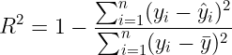
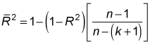
Error metrics in regression models
Metrics:
R2:
Provides a measurement of the “explanatory” power of a model (shows how much variance of y can be explained by the independent features)
Compares the variance of your model’s errors against the “mean model” (model for which all the predictions are the mean of the dependent variable)
Increases with every independent feature you add
Provides a way to compare the performance of several models
Adjusted R2:
Provides a measurement of the “explanatory” power of a model taking into account the number of independent features used by the model.
Only increases if the inclusion of a new feature improves the model’s performance.
Sklearn r2

Slide 19
Where to evaluate the error metrics?
Evaluate the error metrics in:
Train set
Test set
Compare the error metrics in both sets:
If error_train very high -> Underfitting ( consider other model or to add more variables)
If error_train <= error_test -> Ok
If error_train very small and <<<< error_test -> Overfitting!!!! ( you overtrained your model or you did not applied the transformer to the test set ).

Slide 20
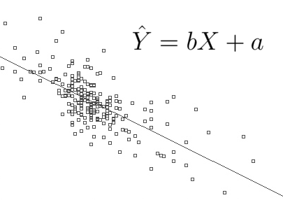
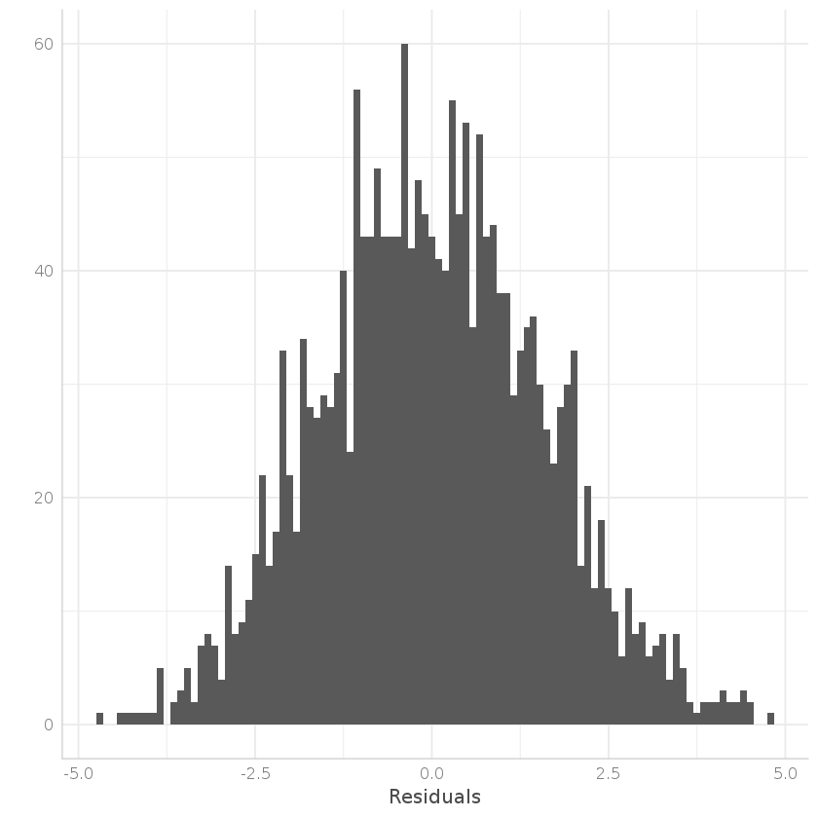
Analyzing your model
Make a scatter plot of the predicted values against the real values. In a perfect model, the predicted values match the real values, therefore you should see an straight line.
Pot the distribution of the residuals (real_value - predicted_value) they should look normally distributed. Deviations from normality means average over/under estimation.

Slide 21
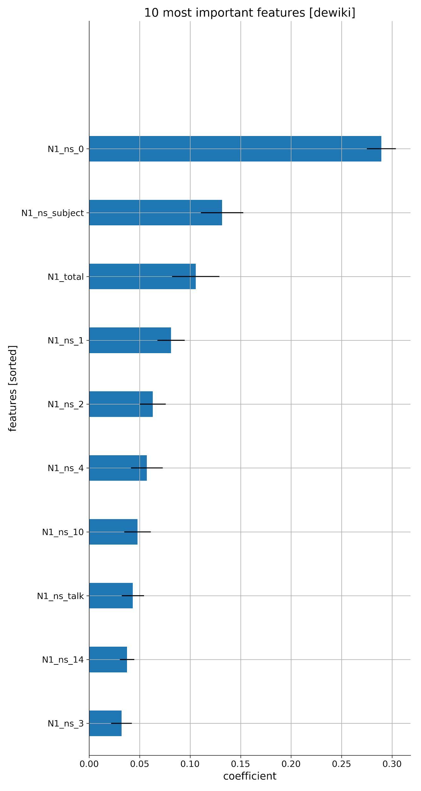
Feature importance
In order to check which independent features are more relevant to your model, compare the absolute value of each coefficient.
Only valid if all the features are in the same scale.

Slide 22
OLS
Additional Readings
https://www.jmp.com/en_us/statistics-knowledge-portal/what-is-regression/simple-linear-regression-assumptions.html
https://aegis4048.github.io/transforming-non-normal-distribution-to-normal-distribution

